Slide 1


Automatic Resume Builder
112103095 Harshal Nandavane
112103096 Mayuresh Narewadikar

Slide 2

CONTENT
01
OBJECTIVES
02
IMPORTANCE
03
IMPLEMENTATION
04
CONCLUSION

Slide 3
OBJECTIVES
Maximize Your Job Opportunities with an Automatic Resume Generator
Limitations of traditional resume writing methods
Importance of a well-crafted resume
More usefull for college students

Slide 4
IMPORTANCE
It ensures that you can remember all the required details.
Easy to read and understand.
Ability to express you effectively.
Increases chances of Selection.

Slide 5

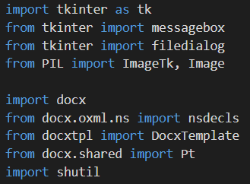
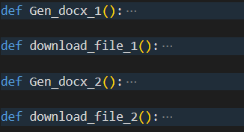
IMPLEMENTATION
Libraries Used :
GUI – Tkinter
Word – Docx
Download - Shutil
Functions :
Gen_docx_1
Download_file_1
Gen_docx_2
Download_file_2

Slide 6

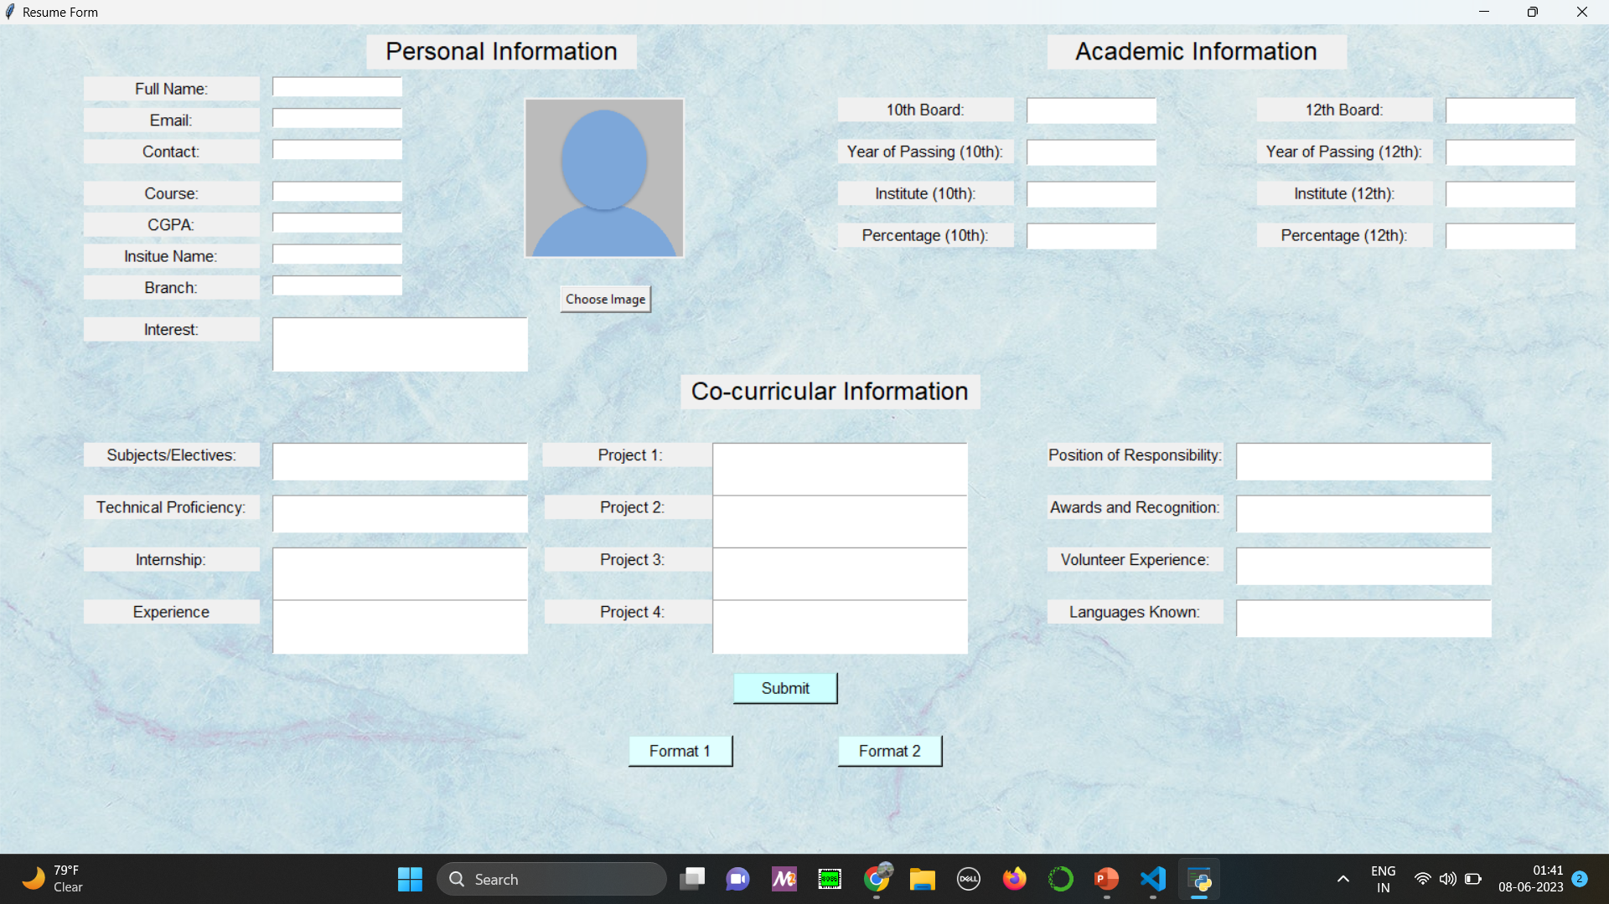
GUI USING TKINTER

Slide 7
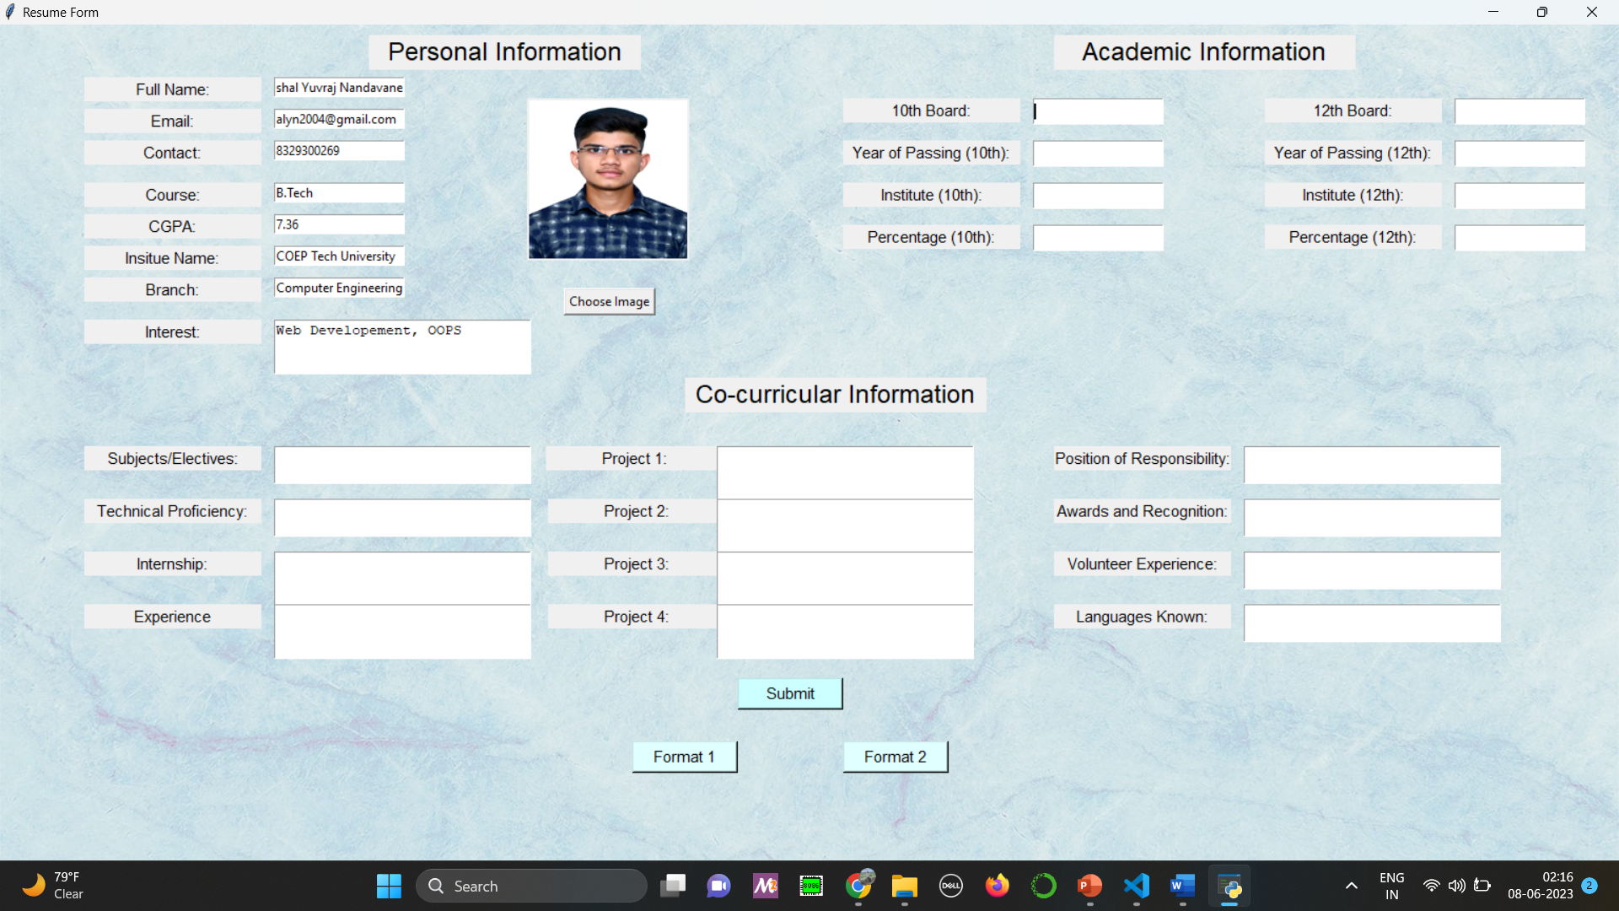
GUI USING TKINTER

Slide 8
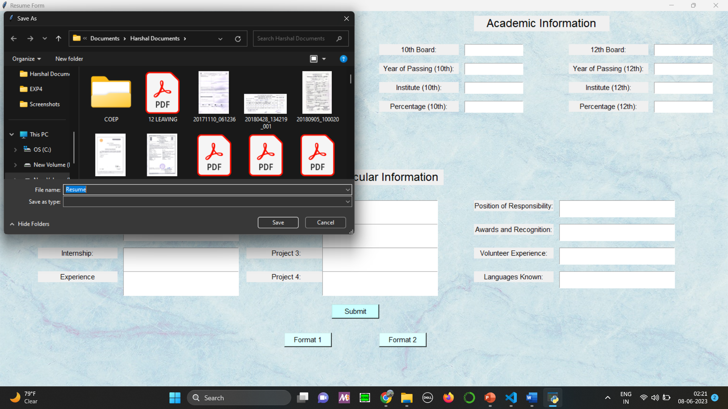
GUI USING TKINTER

Slide 9
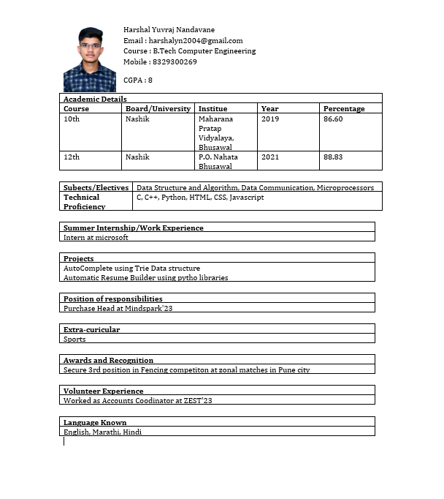
RESUME - DOCX

Slide 10




CONCLUSION
User have two choices of resume. They can download both format. This resume helps user to build resume which increases their selection chances.
More useful for college students
CUSTOMERS

Slide 11

THANK YOU

